Slide 1
Freedom Summer.
Vignettes from the training sessions in Oxford, Ohio at the Western College for Women - June 1964
Photographs by Galen Gockel

Slide 2
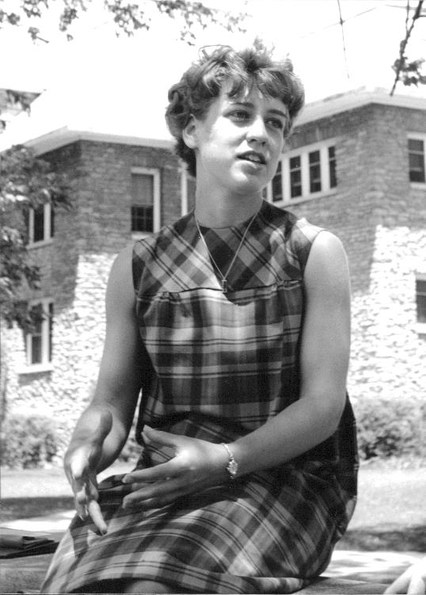
Jean Konzen
--Student Jean Konzen attended St. Mary’s College in Indiana. She reported that her father opposed her participation in the summer project, but that the nuns at St. Mary’s encouraged her to apply.

Slide 3
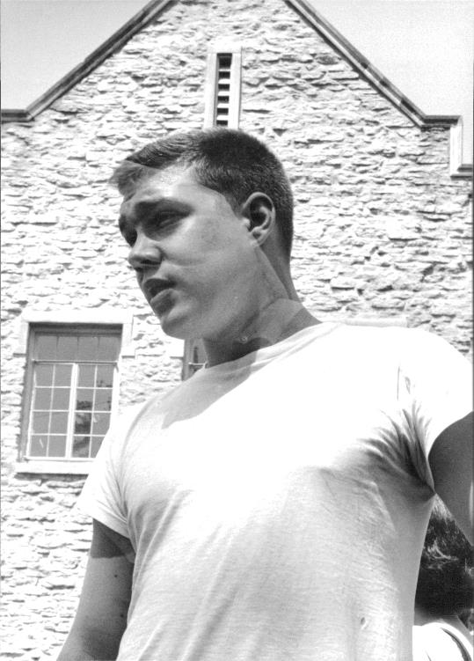
Bill Hilgendorf
--Student Bill Hilgendorf attended Yale University; his hometown was Milwaukee. He reported that SNCC was recruiting participants on campus during the spring semester.

Slide 4
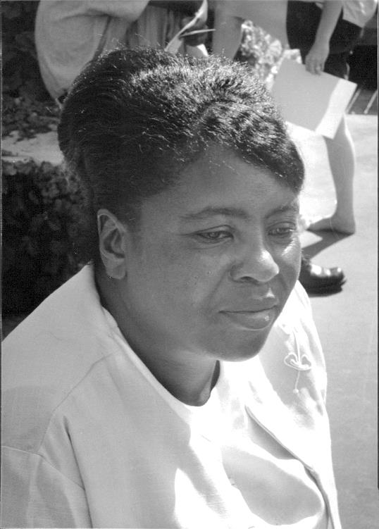
Fannie Lou Hamer
Fannie Lou Hamer from Ruleville, Mississippi attended the training sessions. Later that summer she testified eloquently before the Credentials Committee at the Democratic National Convention. “I’m sick and tired of being sick and tired.”

Slide 5
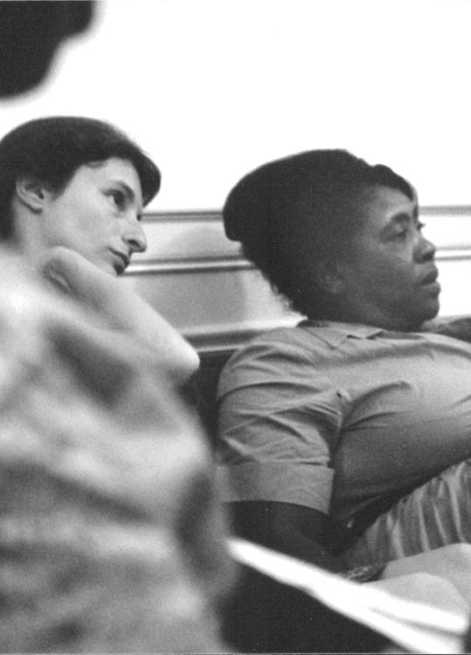
Students gathered around Fannie Lou Hamer in the student lounge each evening.

Slide 6
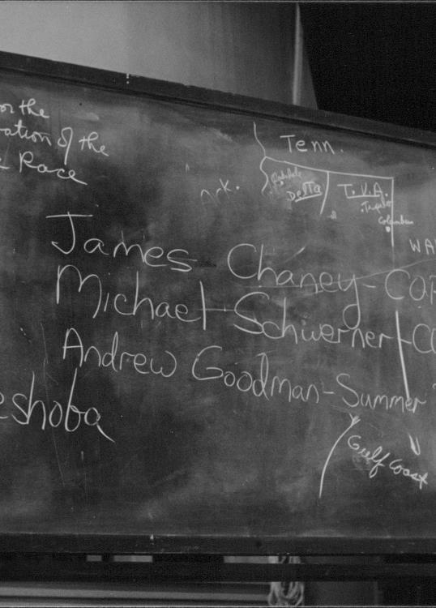
Missing
During the first morning of the training sessions, a young woman reported to the gathered students that 3 civil rights workers were missing. She wrote their names on this blackboard. She was Rita Schwerner, the wife of missing Mickey Schwerner.

Slide 7
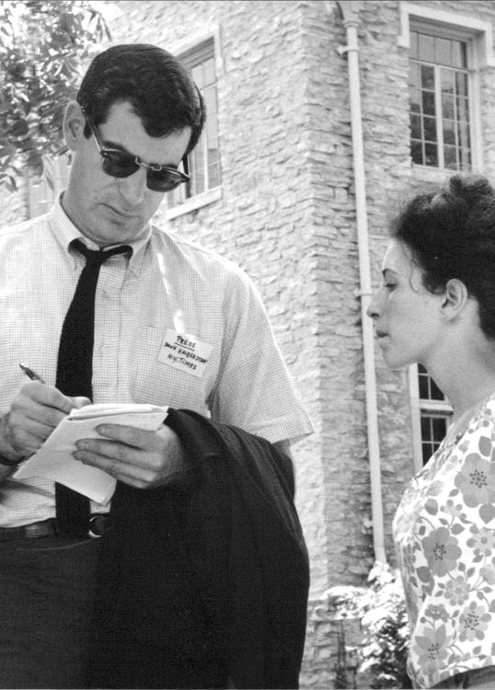
David Halberstam Interviews Rita Schwerner
During a break in the first day’s sessions, NY Times reporter David Halberstam interviewed Rita Schwerner after her report that the three workers were missing.

Slide 8
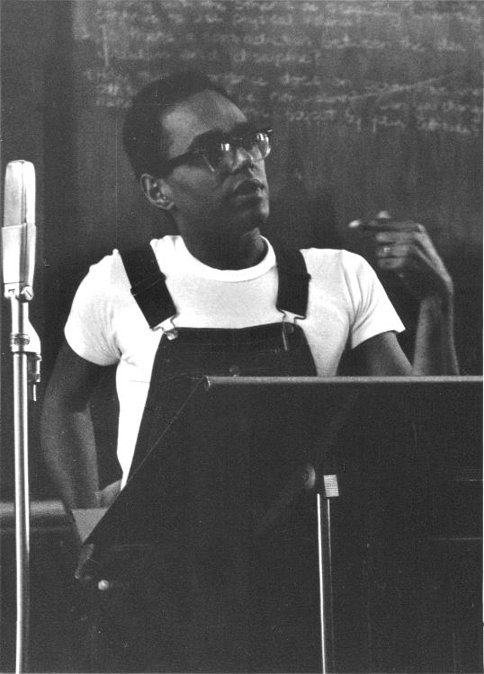
Bob Moses
Civil Rights leader Bob Moses introduced the students to the realities of life in Mississippi, and the hostile reception they would receive.

Slide 9
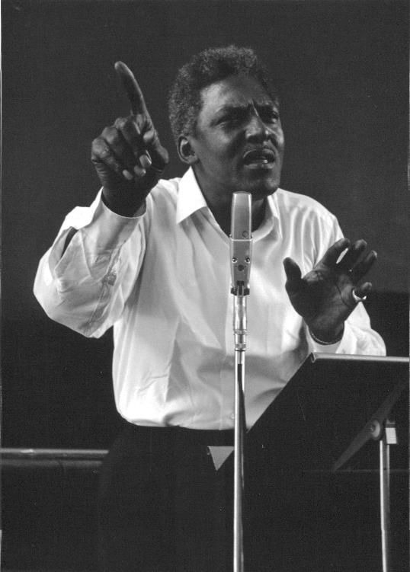
Bayard Rustin
Bayard Rustin also prepared the students for their experiences in Mississippi. “You will feel fear, but you must conquer it”. Rustin had been the lead organizer of the March on Washington the previous year.

Slide 10
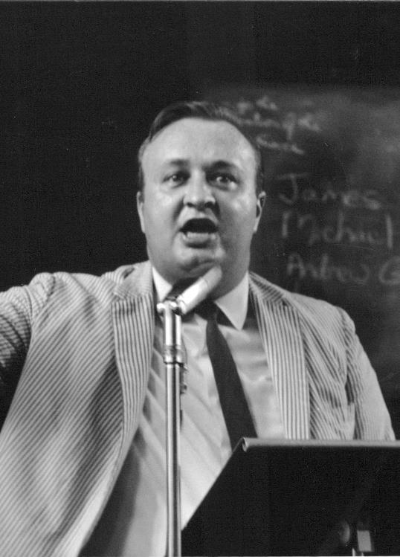
Charles Morgan
Charles Morgan, a civil rights attorney in Atlanta, introduced students to the South.

Slide 11
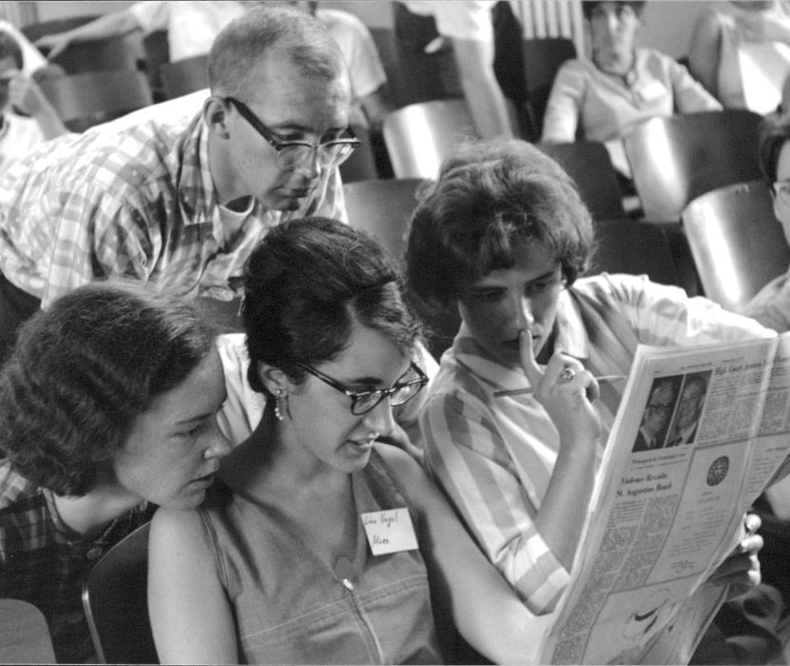
Searching
Students read daily reports of the search for Schwerner, Chaney and Goodman in the local media during breaks in their schedules.

Slide 12
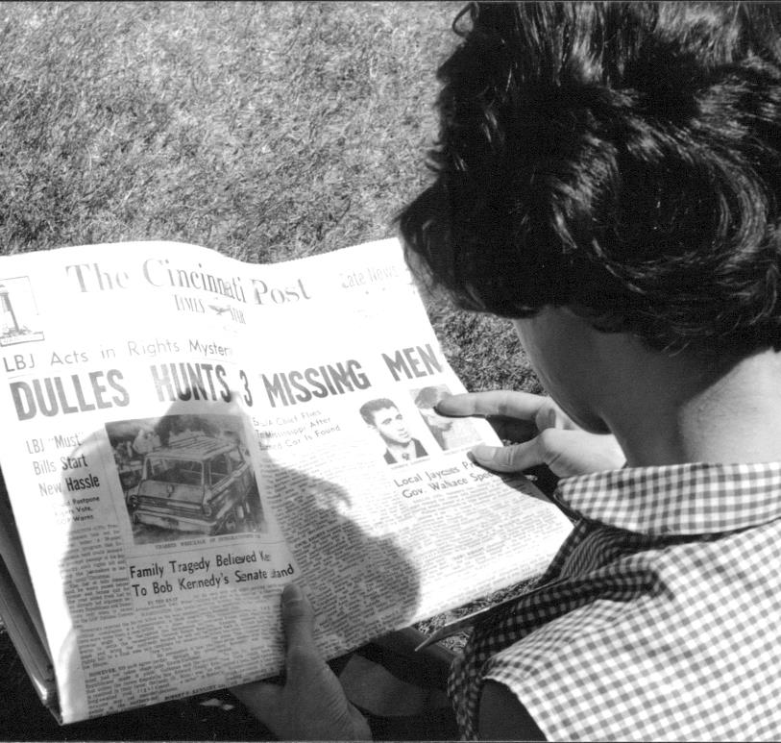
Banner Headlines
Daily reports of the “3 missing men” were the banner headlines in the local newspapers. The students were only a few days from their travel to Mississippi.

Slide 13
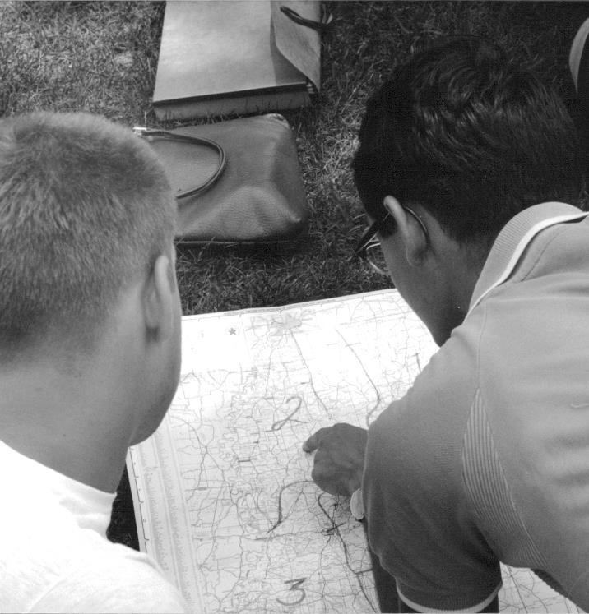
Preparation
Studying a road map of Mississippi during a break in the training

Slide 14
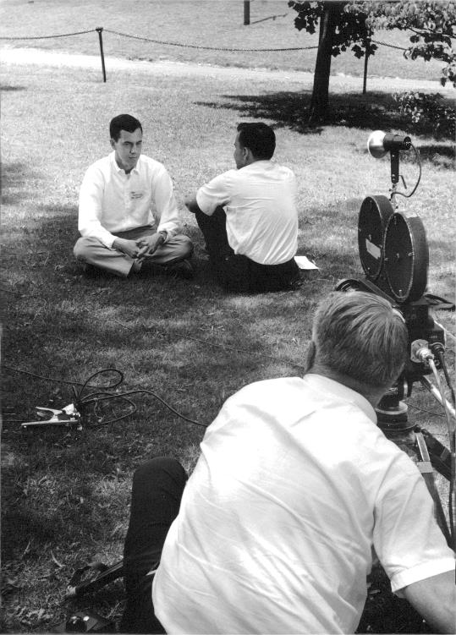
In the media
Television covered the training sessions, and sent daily reports to national media.

Slide 15
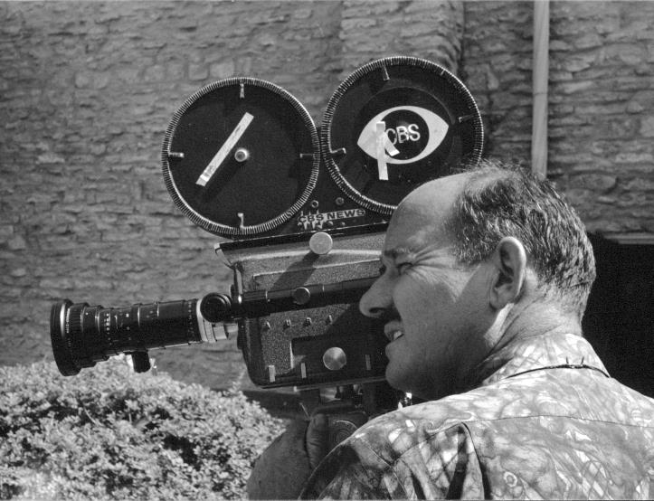
CBS News camera men were shooting footage during the week.

Slide 16
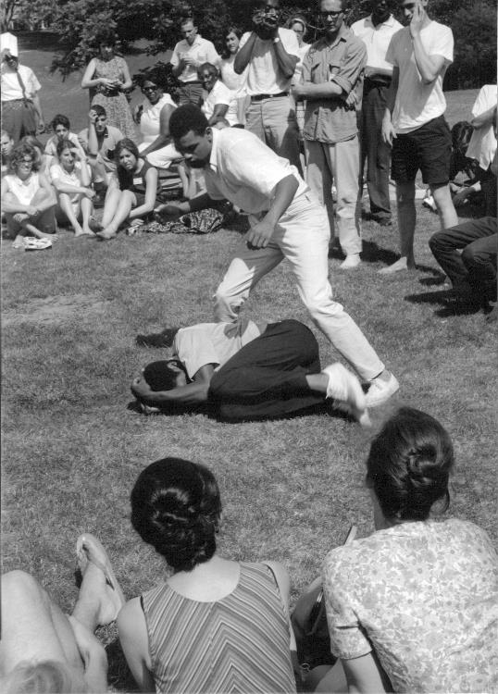
Afternoon role-playing helped students prepare for any violence they might encounter

Slide 17
Thank you
These photographs are from the personal collection of former Oak Park Village Trustee Galen Gockel which represent the faces of civil rights icons as well as those of student volunteers. Mr. Gockel photographed these images in June 1964 at the Freedom Summer training program held for volunteers at Western College for Women in Oxford, Ohio.

